Slide 1

Softmax Regression
The Logistic Regression model can be generalized to support multiple classes directly, without having to train and combine multiple binary classifiers. This is called Softmax Regression, or Multinomial Logistic Regression.
The idea is simple: when given an instance x, the Softmax Regression model first computes a score s_{k}(x) for each class k, then estimates the probability of each class by applying the softmax function (also called the normalized exponential) to the scores.
Equation for Softmax score for class k
Each class has its own dedicated parameter vector θ(k)

Slide 2
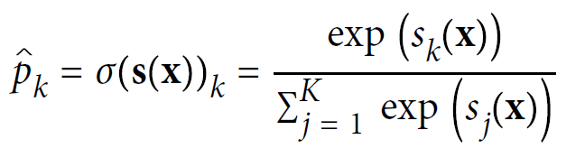
Softmax Regression
Once you have computed the score of every class for the instance x, you can estimate the probability pk that the instance belongs to class k by running the scores through the softmax function.
The function computes the exponential of every score, then normalizes them (dividing by the sum of all the exponentials).
The scores are generally called logits or log-odds (although they are actually unnormalized log-odds).
Equation for Softmax function
K is the number of classes.
s(x) is a vector containing the scores of each class for the instance x.
σ(s(x))k is the estimated probability that the instance x belongs to class k, given the scores of each class for that instance

Slide 3
Softmax Regression
Softmax Regression classifier predicts the class with the highest estimated probability
Equation for Softmax Regression classifier prediction
The argmax operator returns the value of a variable that maximizes a function.
In this equation, it returns the value of k that maximizes the estimated probability σ(s(x))k
The Softmax Regression classifier predicts only one class at a time (i.e., it is multiclass, not multioutput), so it should be used only with mutually exclusive classes, such as different types of plants.

Slide 4

Cross entropy
Cross entropy is frequently used to measure how well a set of estimated class probabilities matches the target classes.
Equation for Cross entropy cost function
y_{k}(i) is the target probability that the ith instance belongs to class k. In general, it is either equal to 1 or 0, depending on whether the instance belongs to the class or not.
When there are just two classes (K = 2), this cost function is equivalent to the Logistic Regression’s cost function

Slide 5
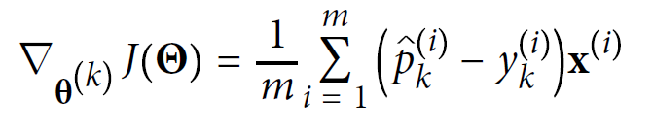
Cross entropy
Equation for Cross entropy gradient vector for class k
Compute the gradient vector for every class, then use Gradient Descent (or any other optimization algorithm) to find the parameter matrix Θ that minimizes the cost function.

Slide 6
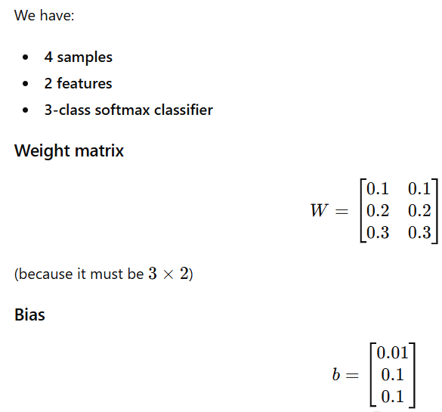
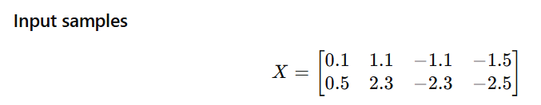
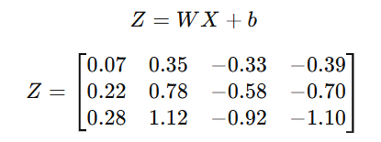

Compute Logits

Slide 7
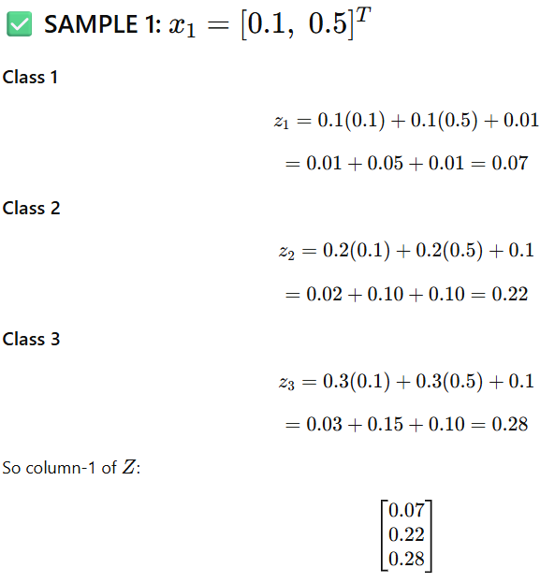
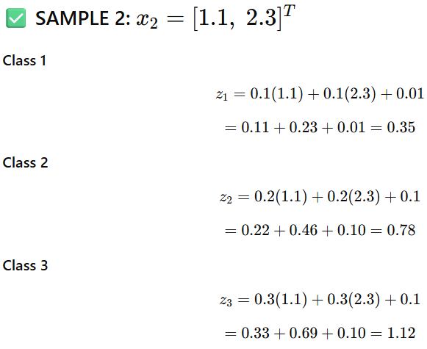

Slide 8
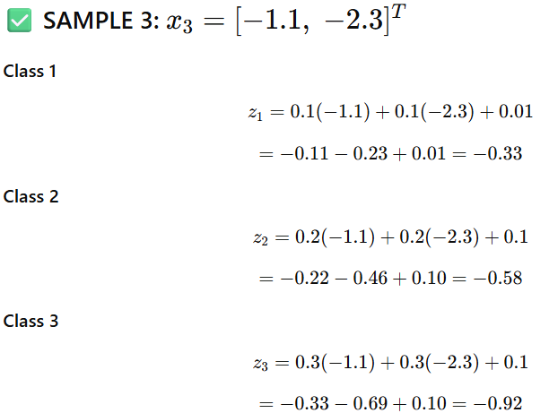
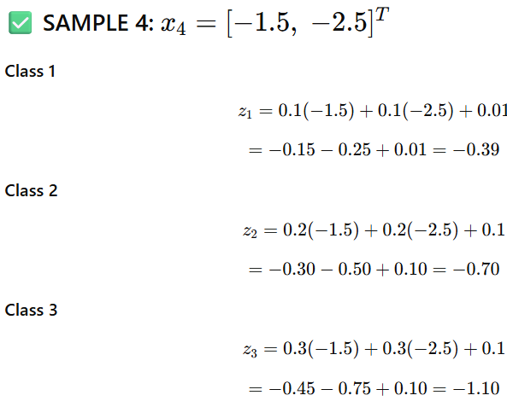

Slide 9
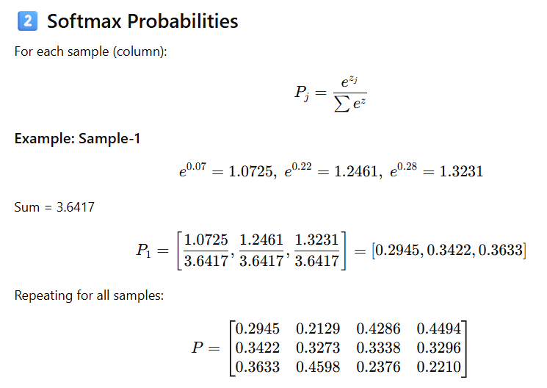

Slide 10
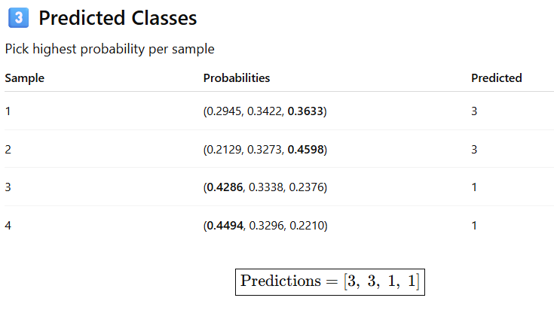

Slide 11
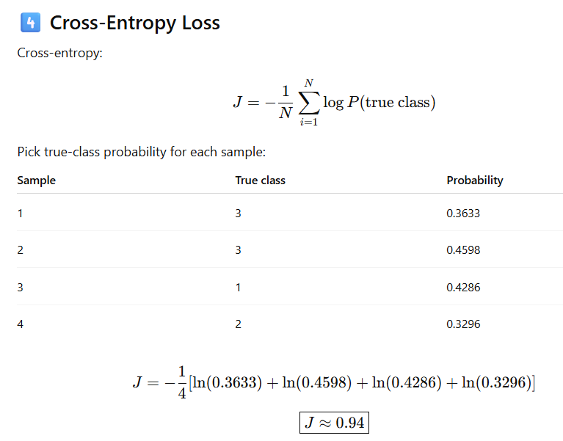

Slide 12
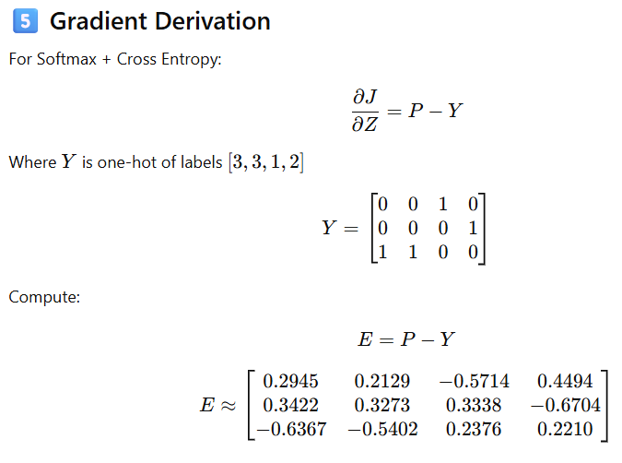

Slide 13
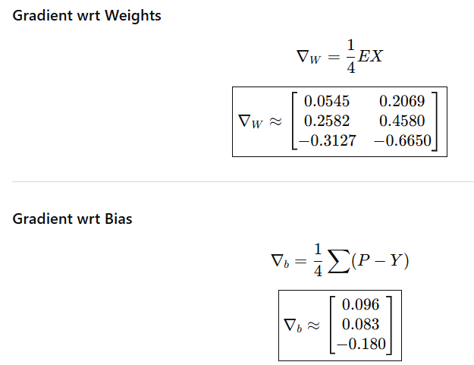

Slide 14
